Slide 1
Fantasy Football
Data Science Challenge
September 2023

Slide 2

Data Science Challenge
Agenda:
Purpose
Rules
Winning
Post Activity
Time Line

Slide 3
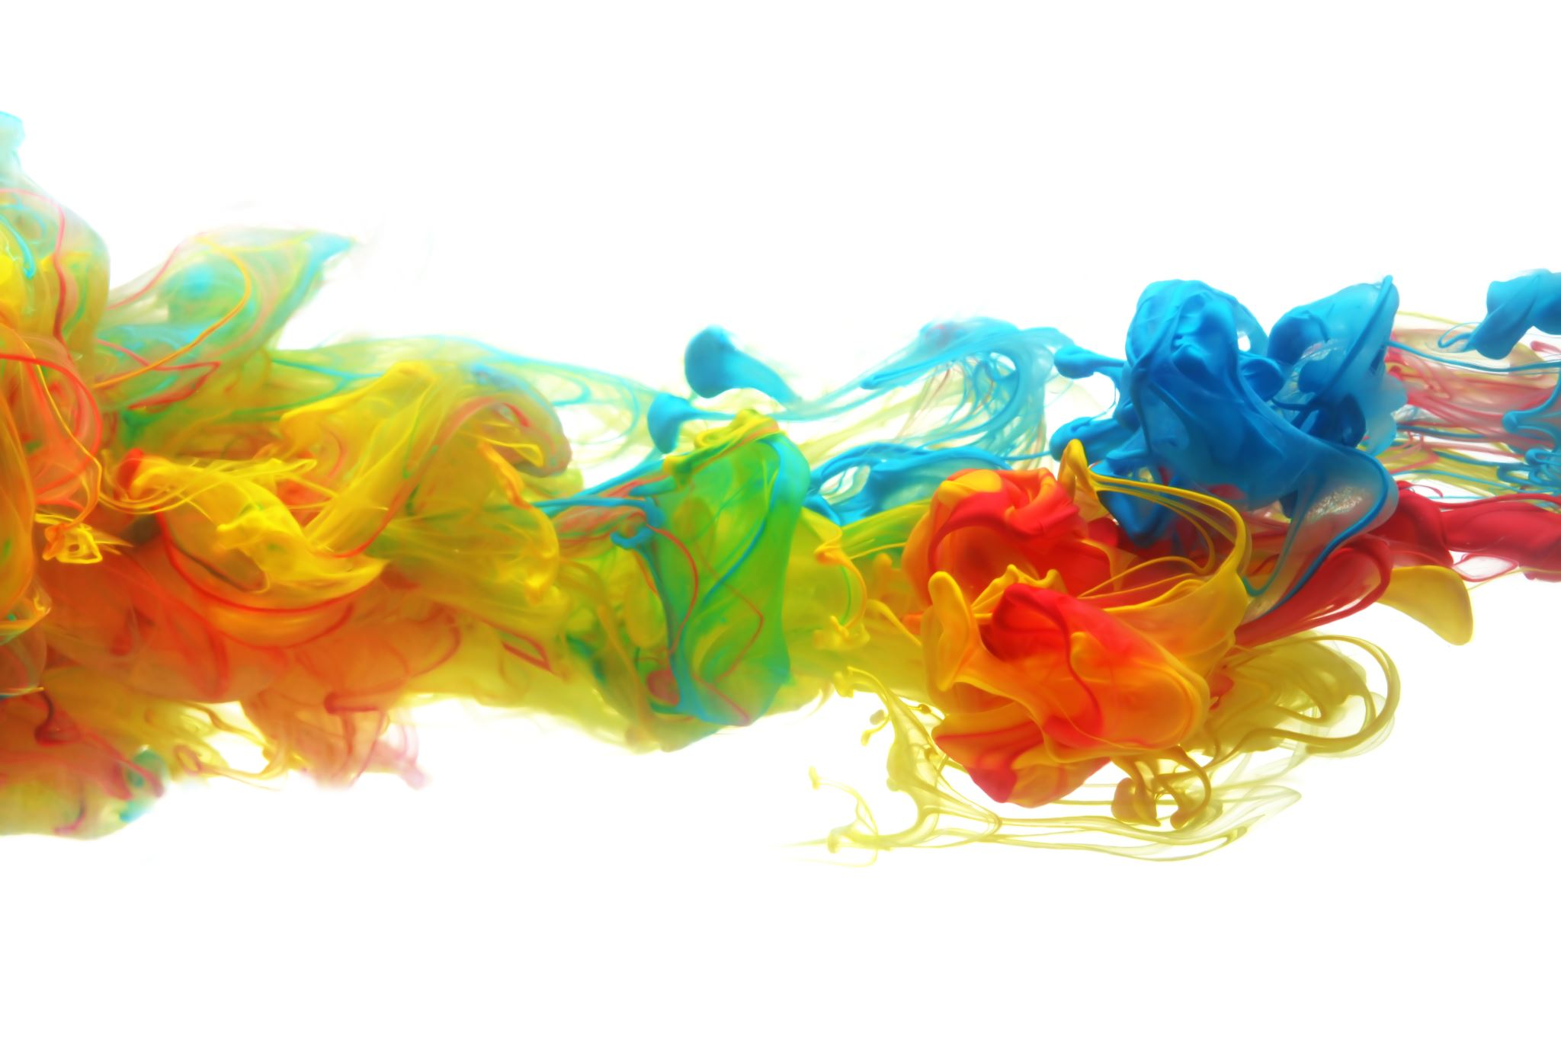
Purpose
Purpose:
Challenge self
Competition
Grow
Spur Innovation
Connect
Notes:
Most important aspect of this Data Science Challenge is to Challenge ourselves

Slide 4

Contest Rules
General
Model must make picks (honor system)
1-3 members per team
Weekly Goal
Score most fantasy points compared to other models
End of Season Goal
Score most fantasy points overall
1st place, 2nd place
Most innovative model
Notes:
* Draft on weekly basis?

Slide 5
Game Rules
Weekly Challenge
$60,000 salary cap
Will pick 9 Players (1 QB, 2 RBs, 3 WRs, 1 FLEX, 1 TE, 1 DEF)
Salaries will be released Wednesday
Rosters From each Team submitted Thursday
14 weeks in the season (NFL weeks 4-17)
No Playoffs
Quirky Rules
0.5 PPR
No Kickers
Notes:
* Draft on weekly basis?

Slide 6
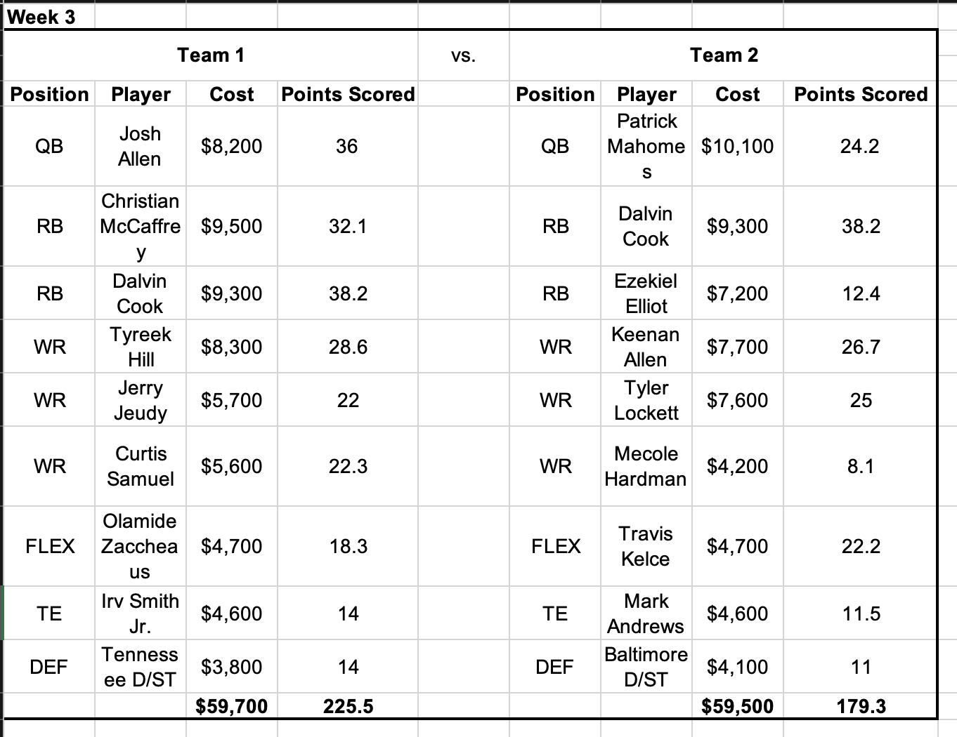
Weekly Matchups
Notes:
* Draft on weekly basis?

Slide 7
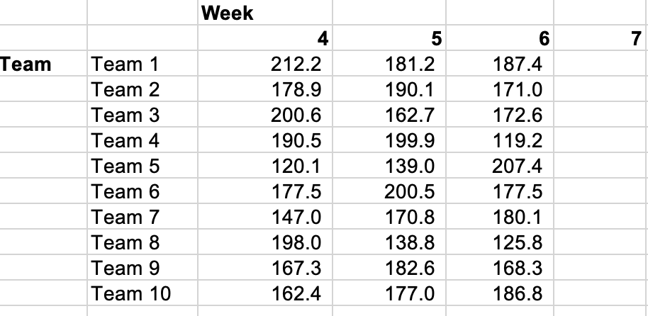
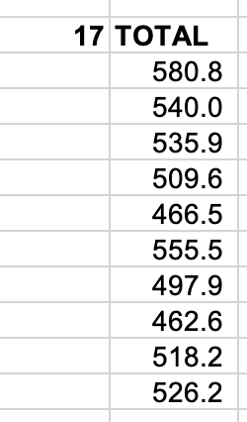
Weekly Points
Notes:
* Draft on weekly basis?

Slide 8
Weekly Prizes
Each Week
10 weeks in season
BAH swag up for grabs each week
Notes:
* Draft on weekly basis?

Slide 9
End-of-Season
Reward Structure
Each week score the most points to win swag
3 payouts totaling $100 up for grabs
Payouts in Gift cards (TBD)
Highest points scored $50
Second highest points scored $25
Most innovative model: $25
Notes:
* Draft on weekly basis?

Slide 10
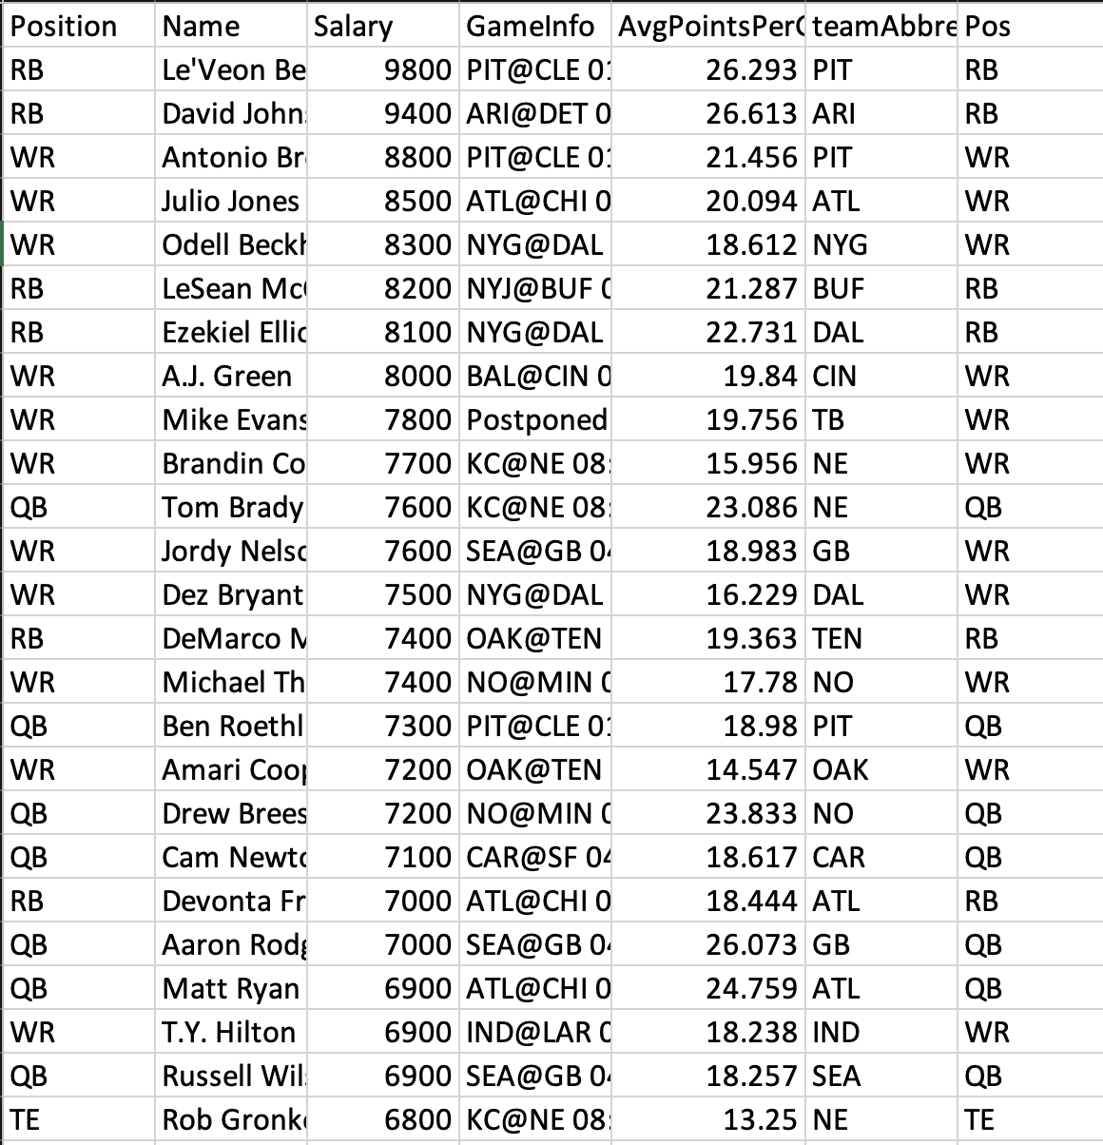
Data Sources
Player Salary Data
FanDuel salary cap data and rules
Rotoguru.com
Weekly matchup data
Pro-football-reference.com
Other Stats
Can be collected by each team from their own data sources
For Example: catches, historical points, rushing yards, etc.
Notes:
Draft on weekly basis?
Fantasy pros

Slide 11
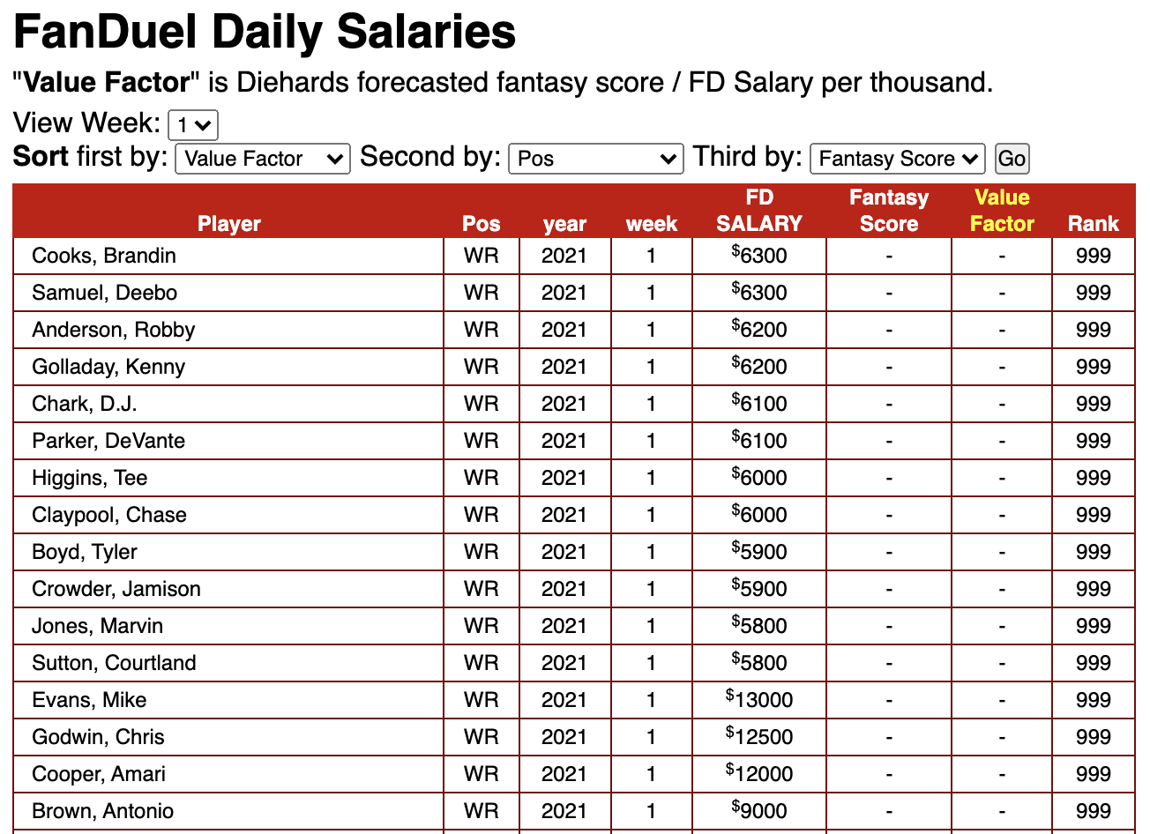
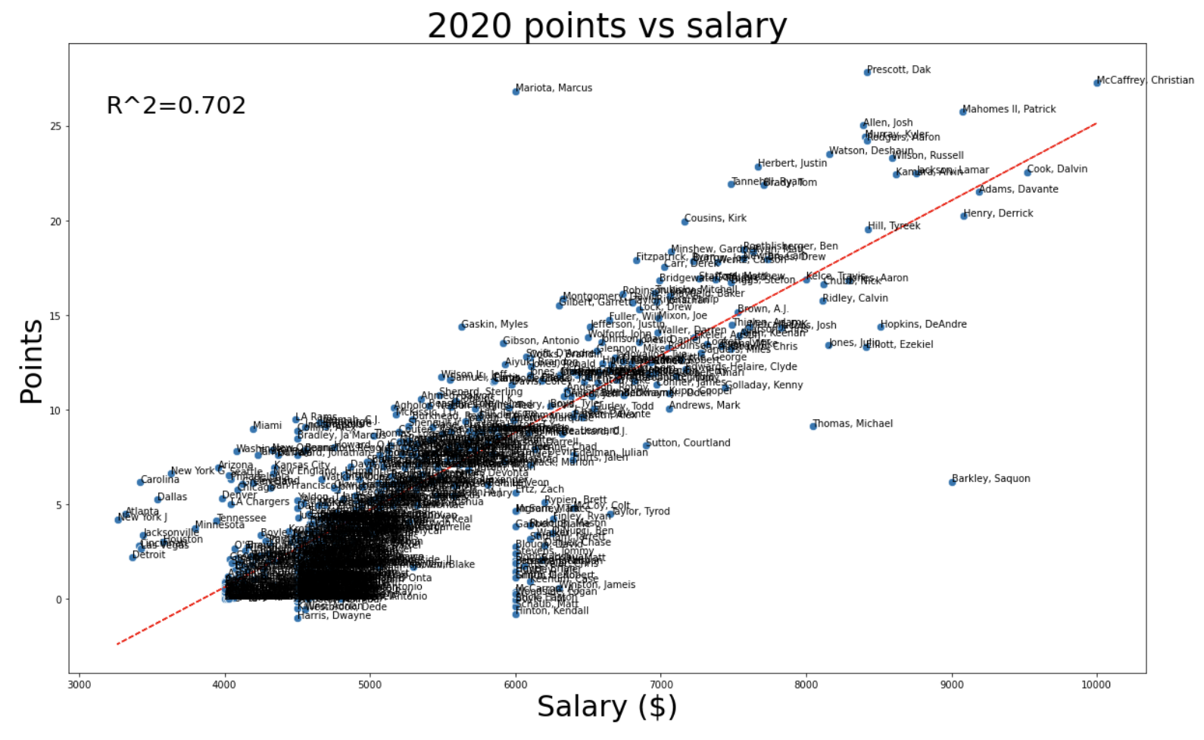
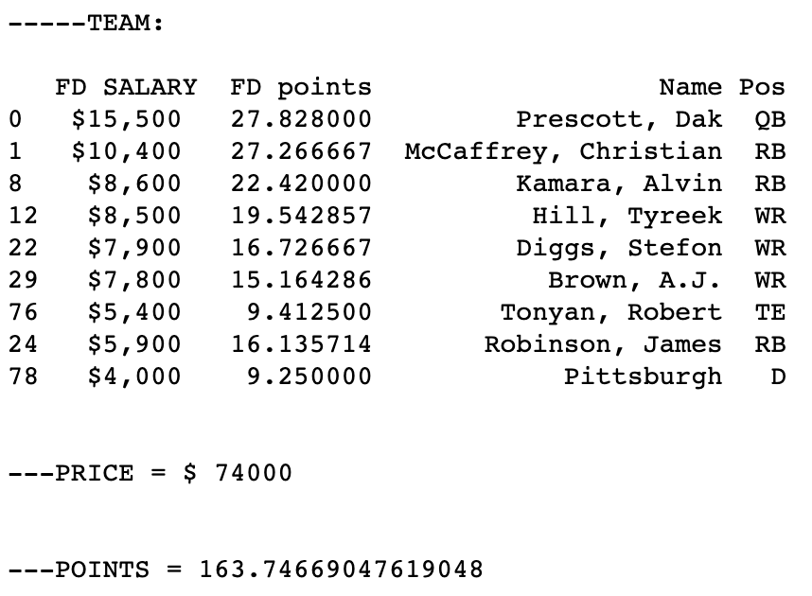
Sample Model
Notes:
Draft on weekly basis?
Fantasy pros

Slide 12
Every Monday Night Scores are calculated and weekly winners are determined
Sept 28: First team submissions
Dec 11: Last game of our season
Sept 6: Slack announcement of competition
Every Wednesday Salaries are released
Season Prep
Regular Season
Post Season
Sept 11: Kickoff meeting
Dec 15: Contest Winners are announced and
After Action Review
conducted
Every Thursday team picks due by noon PCT
Notes:
Pre- Season
Tell League Managers about interest and team composition before Week 4
Venmo League managers $10
Receive invite to Slack Channel/OneDrive
Pre-season meeting with every model team
During the Week
NFL games run Thursday night to Monday night
FanDuel Salaries posted on Wednesday in OneDrive Excel sheet
Players post selections on Thursday in OneDrive Excel sheet
League managers update weekly scores/money earned
End-of-Season
After action meeting at the end to discuss models
Award best model prize

Slide 13
Questions?

